Slide 1

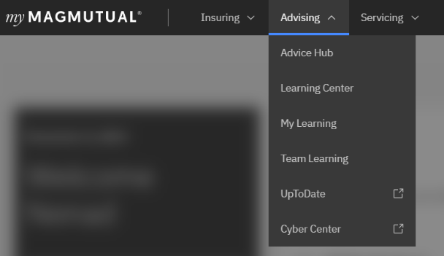
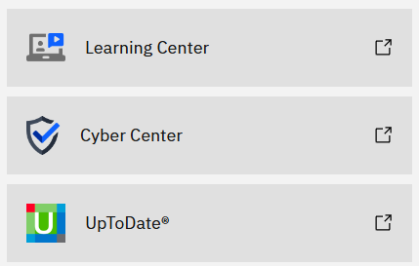

Accessing the Cyber Center in MyMagMutual Portal
Register: If you haven’t registered yet, create an account on the MyMagMutual portal by visiting http://www.magmutual.com/login and clicking the Register link.
Log In: Use your registered credentials to log into the MyMagMutual portal.
                Please contact technical support if you are having issues.
Access the Cyber Center:
From the top navigation menu click Advising select Cyber Center link to go directly to the page
                or
From the Advice Hub page click Cyber Center box link
1
2

